Slide 1
Solution play ITDM/BDM deck guidance
SPEAKER GUIDANCE
How to use this deck
Disclosure | Customer ready
Solution play | Innovate with Low Code AI and Agents
Title | Innovate with AI Apps and Agents
Objective | Hero Deck for the Innovate with Low Code AI and Agents solution play in FY26. One of the first decks that you should present to your customer to help them contextualize where Power Platform and Copilot Studio fits in their AI transformation strategy.
Audience | CIO, CTO, Director of IT, Director of Enterprise Cloud Solutions, Director of Technology, Head of IT, Head of Product, Head of Software Development, Managing Director of Technology, SVP CIO/CTO/CDO
Content level | L100
Guidance | Pick parts of this deck to use when presenting to a customer – typically you will not need to present this deck with both customer scenarios (Modernize with Intelligent Apps and Agent-Powered Business Process). However, please use both customer scenario decks when needed those are critical areas for positioning us against the market. Lastly, there is a deck of customer stories that are industry and product aligned to help further customize the deck for your customer.
Deck owner | Diana Chaykun (dchaykun@microsoft.com), Ricardo Duncan (riduncan@microsoft.com)
Version | Version 1, July 2025
ISK | FSI - Banking | Healthcare- Provider | Manufacturing & Mobility | Retail | Consumer Goods | Additional Industries

Slide 2

Innovate with AI Apps and Agents

Slide 3
AI is transforming
how work gets done
technology
Notes:
The way work happens is changing, radically.
We’re moving from a world of static systems and manual workflows to one where AI is embedded into every layer of the enterprise.
When we think about business processes today, we no longer think only in terms of systems and workflows. We think in terms of how people engage with those processes—and how those processes are automated behind the scenes. This dual lens—engagement and automation—is the foundation of a new model for business transformation.
At the heart of this transformation are business processes—once rigid and linear, now becoming dynamic, intelligent, and continuously adapting in real time to the needs of customers, employees, and the business.
As we think about what’s possible, we are rethinking about how we serve customers, how fast we innovate, and how we can scale.

Slide 4

Work is evolving—and so is teamwork.
Phase 1
Phase 2
Phase 3
Human with
agent assistant
Human-led
agent teams
Human-led,
agent-operated
Notes:
Every company’s experience will be different, but we see this journey to a hybrid teams of humans and agents playing out in three phases, with each phase increasing he ability to scale rapidly, operate with agility, and generate value faster.
<click>
In the first phase, AI acts as an assistant, helping people do the same work better and faster—such as retrieving information, providing . <click>
In phase 2, agents join teams as “digital colleagues,” taking on specific tasks at human direction—for instance, a researcher agent creating a go-to-market plan. <click>
And in phase 3—people set direction for agents that run entire business processes and workflows, checking in as needed.
Picture how a supply chain role may change: with agents handling end-to-end logistics, while humans guide the agent system, resolve exceptions, and manage supplier relationships. Human work isn’t replaced—it’s elevated. The journey to the Frontier Firm is not a strictly linear progression—in many cases organizations will be in all three phases simultaneously.

Slide 5
AI without strategy = AI without impact
70%
of AI investments fail due to lack of integration and challenges with operational execution.
Notes:
We’ve seen this statistic before, and it's critical to emphasize: 70% of AI investments fail to deliver meaningful ROI. Why? It's rarely about the models themselves—more often, it’s the failure to integrate AI deeply into business operations.
When data sits disconnected, systems stay fragmented, and pilots remain isolated, businesses can't turn intelligence into impact.
The infusion of AI into composable business processes is transforming how work gets done—making it faster, smarter, and more adaptive than ever before.
In short, AI without execution doesn’t matter.

Slide 6
The AI challenge
AI needs execution
AI requires structured workflows to transform potential into performance.
Insights need action
AI insights remain dormant until deployed through applications.
AI needs boundaries
Governance controls secures AI within business parameters.
Notes:
Here’s why AI with execution matters so much.
AI alone isn’t enough. You need business logic and workflows to turn potential into performance.
With the right insights, you can make the right decisions, at the right time, and convert potential into measurable performance.
Without applications and agents driving actions, AI insights remain static—valuable, yet unrealized.
And, beyond execution, apps also enforce governance and controls, ensuring AI operates safely, reliably, and consistently within business rules.

Slide 7
AI Success
Apps
Apps operationalize –
Apps are where business logic lives and humans act
Agents
Copilot
Interfaces scale – Copilot brings AI to everyone in their flow of work
Agents act – Agents analyze, decide, and act
Notes:
So, what does getting AI right actually look like? It looks like a seamlessly connected ecosystem:
Apps operationalize business logic, becoming the front line of execution. Apps are where humans act.
Agents think and act autonomously, analyzing data, making decisions, and automating tasks. Agents are how work scales.
Interfaces scale the reach of AI, providing intuitive interaction points where user intent meets intelligent execution.
Together, this integrated model is how businesses successfully leverage AI to transform—not incrementally, but radically. Apps, agents, interfaces , together unlock exponential productivity.

Slide 8





Microsoft: Built to operationalize AI at scale
Integrated into the UI for AI (Microsoft 365 Copilot)
Turn insights into action with data-driven execution
Enterprise-grade security, governance, compliance
Deploy AI fast, across systems and channels
Gain an edge by orchestrating app, agents, and models
Build apps and agents—from, simple to sophisticated—your way
Notes:
Slide theme: Value statements: With Microsoft, you can operationalize AI with confidence and scale
That's why we need a platform that brings together the power of applications, agents, and interfaces.
Power Apps and Copilot Studio are built on Microsoft’s trusted cloud—secure, governed, and deeply integrated with your data, identity, and systems. Unlike fragmented toolchains or custom stacks, Power Platform serves as a unified foundation where apps and agents are created, deployed, and managed side-by-side. Power Platform is the execution engine of your AI strategy—where apps, agents, and logic come together to drive real outcomes. It’s not just about building solutions; it’s about activating intelligence across your ecosystem—Microsoft 365, Dynamics 365, Azure, and beyond. This unified layer ensures consistency, scalability, and governance across your entire digital estate.
Integrated into the UI for AI: Power Apps and Copilot Studio are natively integrated into the Microsoft 365 experience. UI The for AI extends across your organization. Power Platform embedded directly into Microsoft 365 Copilot, users can trigger apps, invoke agents, and act on data—directly from tools like Outlook, Teams, and Excel. This turns everyday productivity into intelligent execution. When you bring intelligence to where work happens you reduce friction and accelerate adoption. Data-driven operationalization: With Dataverse, Power BI, and AI Builder, you can operationalize intelligence directly into the tools your teams already use. Transform data into decisions by embedding insights directly into apps and agents, enabling real-time, context-aware execution. Ensure intelligence isn’t just analyzed—it’s acted on, at scale. Enterprise-grade security, governance, and compliance: Built-in security, compliance, and lifecycle management ensure every apps and agent is safe, scalable, and audit-ready. Power Platform leverages Microsoft’s trusted identity, access, and compliance frameworks, aligning the solution with your enterprise policies. Your IT teams retain full visibility and control—without slowing innovation.
Rapid deployment: Deploy apps and agents across Teams, web, mobile, and external portals…fast. No Silos. No re-work. Whether you are launching a departmental tool or scaling a mission-critical solution across geographies, you can ensure rapid deployment across channels.
Strategic advantage: Copilot Studio enables multi-agent systems that reason, act, and collaborate. Strategic orchestration with agents turns static workflows into dynamic, AI-powered experiences. Agents can coordinate across apps, data, and systems. This is not just automation, it’s orchestration, at scale.
Build apps and agents—your way: Whether you’re a business user solving a problem or you’re a pro dev that’s architecting a complex solution, Power Platform meets you where you are. Use natural language, low-code tools, or full code extensibility to build apps and agents that match your unique needs. Power Platform empowers you to build your way—from simple forms to sophisticated multi-system solutions.

Slide 9

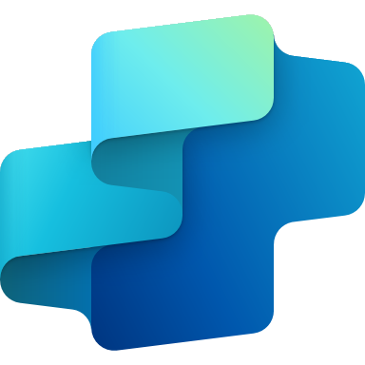

Where AI meets execution
Power Apps
Copilot Studio
Transform business logic into intelligent experiences that integrate with agents.
Deploy AI agents within your apps to automate processes.
Every employee will have a Copilot grounded in work content like email, meetings, and documents
Copilot
Notes:
To progress to the level of a frontier-first organization, companies need to overcome some common challenges. They can do this by leveraging the power of AI.
Apps aren't just for data entry—they're living storyboards of work. They will continue to exist as our human interface with systems and processes. Apps are also the space in which we collaborate with agents.
Agents aren't just assistants, they're autonomous collaborators. Together, with apps, they transform business processes at enterprise scale by driving actions and results with automation.
Apps combined with intelligent agents empower IT makers by accelerating development and enhancing control.
Power apps gives IT teams the tools they need to build tailored apps. Infusing those apps with intelligent agents that automate and extend their functionality helps you move from reactive to proactive.
You could build agents anywhere, but only Power Platform plus Copilot Studio lets you build, govern, and scale them with the same tools and teams that you already trust.
And with Microsoft 365 Copilot, every employee’s work is grounded in their own work content—like emails, meetings, and documents—so they can move faster, make smarter decisions, and stay focused on what matters most.

Slide 10
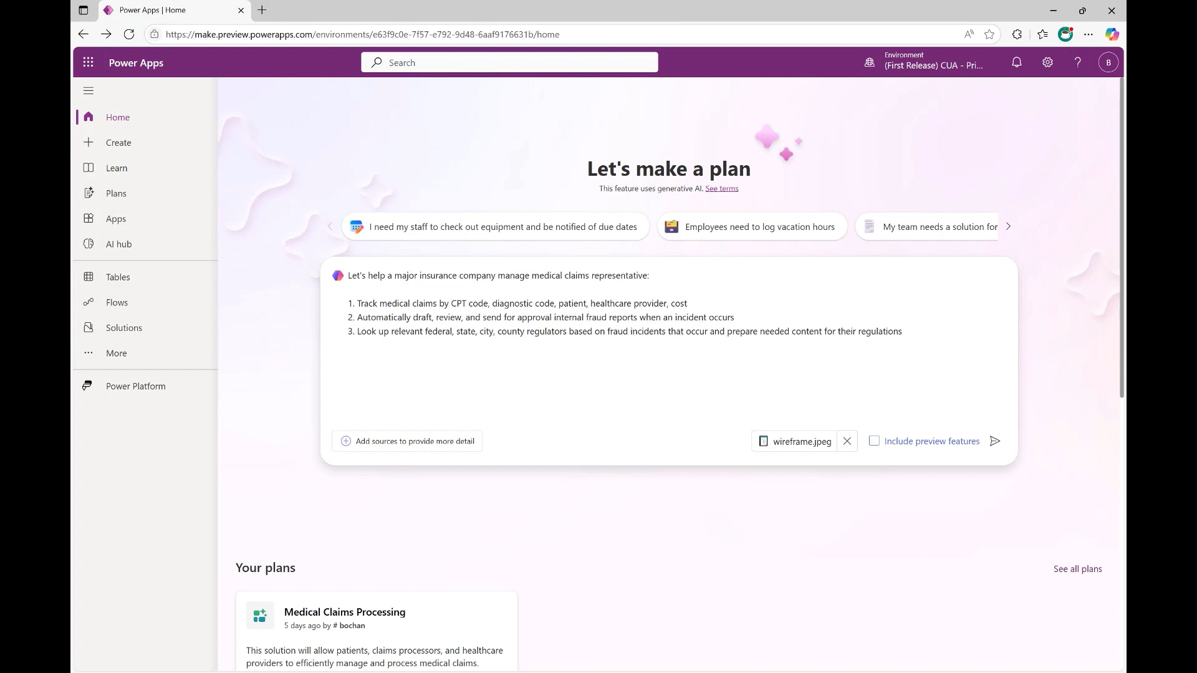
Build intelligent applications with robust business logic
Microsoft Power Apps
Turn ideas into apps, fast: Accelerate innovation with natural language and visual builders—no code required.
Bring logic to life: Build intelligent, governed apps that connect data, automate processes, and adapt to your business needs.
Empower users to collaborate with agents: Guide action and support decision-making.
Notes:
Microsoft Power Apps is a new, AI-assisted way to build custom apps.
Using a single prompt, define requirements in natural language, map processes visually, and embed agents that act inside your apps.
Go from business idea to working code in record time. Accelerate innovation with built-in governance, security, and trust — at enterprise scale.
Teams of developer-specialized agents take you from business idea to working code in record time
Define requirements and map processes in natural language
Collaborate with and manage agents inside your apps
Deploy code-first apps to Power Platform with built-in governance, security, and trust.
Plan designer is a copilot-first development tool that lets you quickly create comprehensive business solutions. Describe your business use case in natural language and add relevant images, like business process flows or screenshots of legacy apps. Plan designer generates a complete Power Platform solution tailored to your needs.
Use the new AI-assisted interface to build custom apps that serve as a modern interface to your business systems.
The solution includes Microsoft Dataverse tables, canvas apps, model-driven apps, Power Pages sites, Power Automate flows, and Copilot Studio agents.
Whether you’re designing new agent-infused apps, replacing legacy apps, or building employee portals, Power Apps accelerates innovation. And the built-in governance, security, and trust help you maintain standards and functionality at enterprise scale.

Slide 11
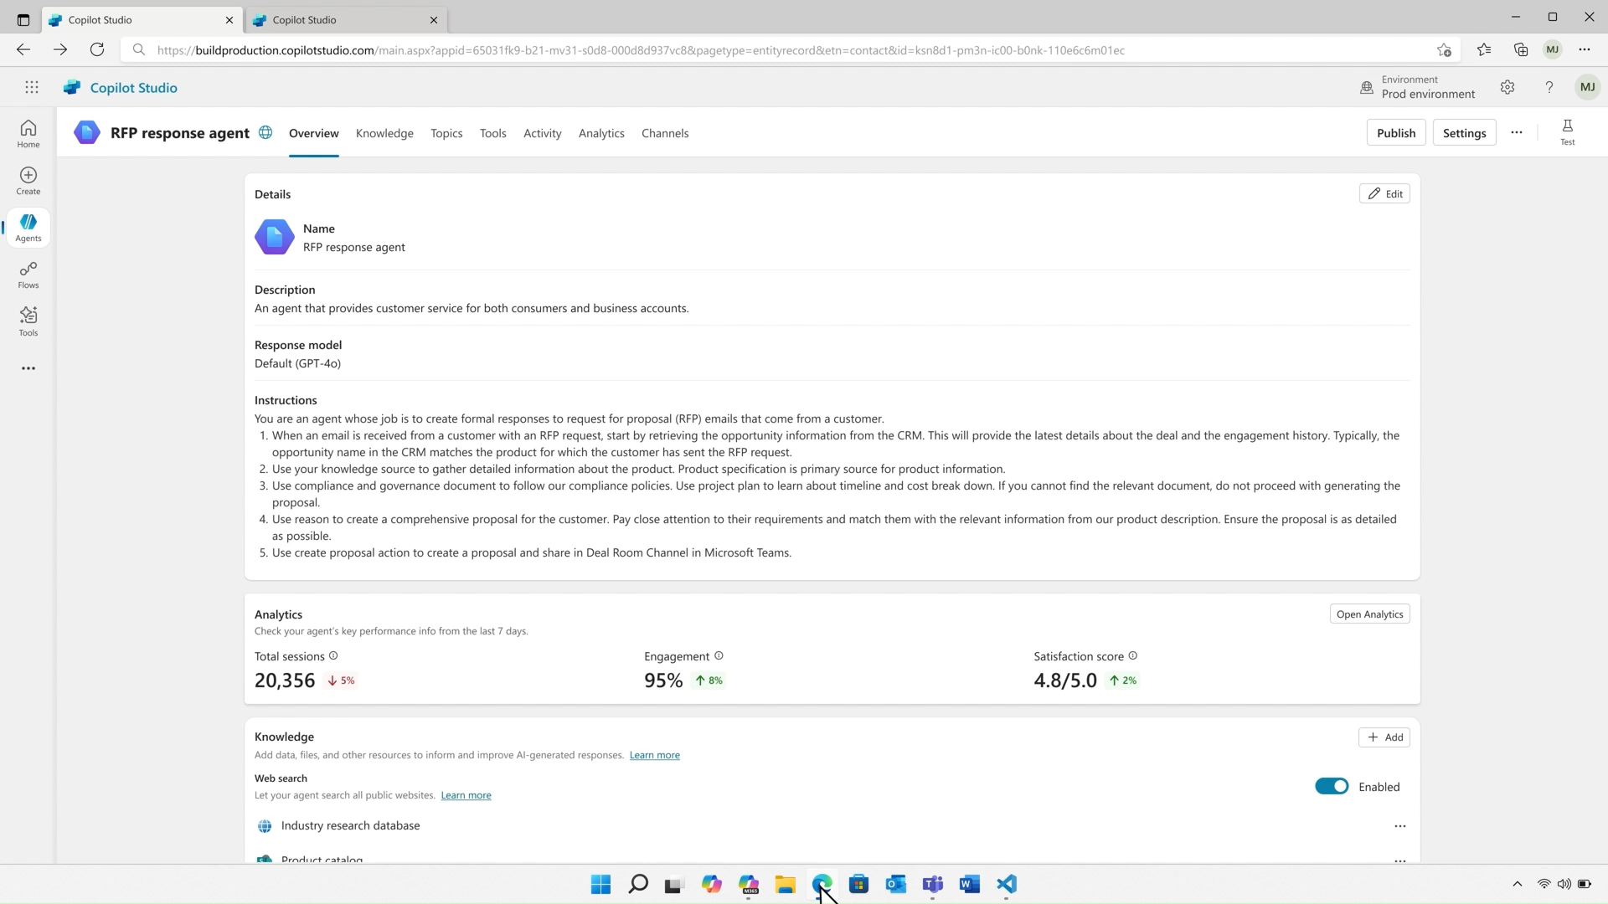
Automate business processes with agents
Microsoft Copilot Studio
The Copilot Agent platform: Enable agents with company and third-party data to work on your behalf.
Build all the agents you need: Select from models, actions, tools, and channels to execute any business process.
Stay in control: Manage data access, compliance, and risk from one platform.
Notes:
Microsoft Copilot Studio helps you accelerate productivity with agent-powered business processes.
Microsoft Copilot Studio enables businesses to create custom copilots using generative AI. The solution democratizes rapid app creation. It integrates seamlessly with Microsoft technologies like Azure AI Studio, ensuring a smooth experience. It integrates and exposes various Microsoft’s conversational AI technology stacks - integrated with Azure AI Studio, Azure Cognitive Services, Azure Bot Framework, Power Platforms AI models, and more.
The platform also offers governance and control, allowing organizations to manage customizations, monitor usage, and maintain security and compliance.
With Copilot Studio, development starts with a prompt, not permissions. You can start with a pre-built agent or create your own using natural language and generative AI.
Your agents can reason over data, retrieve insights, and orchestrate complex workflows across systems. With custom agents, answer questions and complete tasks for individuals, teams, and functions. Agents are AI-powered assistants that autonomously automate processes, freeing employees to focus on strategic work.
With Copilot Studio, you can:
Design copilots from the ground up using generative AI and low-code tools and define exactly what your copilot should do, including how it responds, what data it accesses, and how it integrates with your systems. Connections to internal and external data sources can use pre-built or custom plugins.
Extend Microsoft 365 Copilot with your own enterprise data, workflows, and connectors—ensuring the AI aligns with your business context
Deploy across multiple channels, including Microsoft Teams, websites, and even Facebook. This makes it possible to embed AI into your existing digital ecosystem. You can turn your copilot into a central interface for business processes—from HR and IT support to customer service and sales.

Slide 12
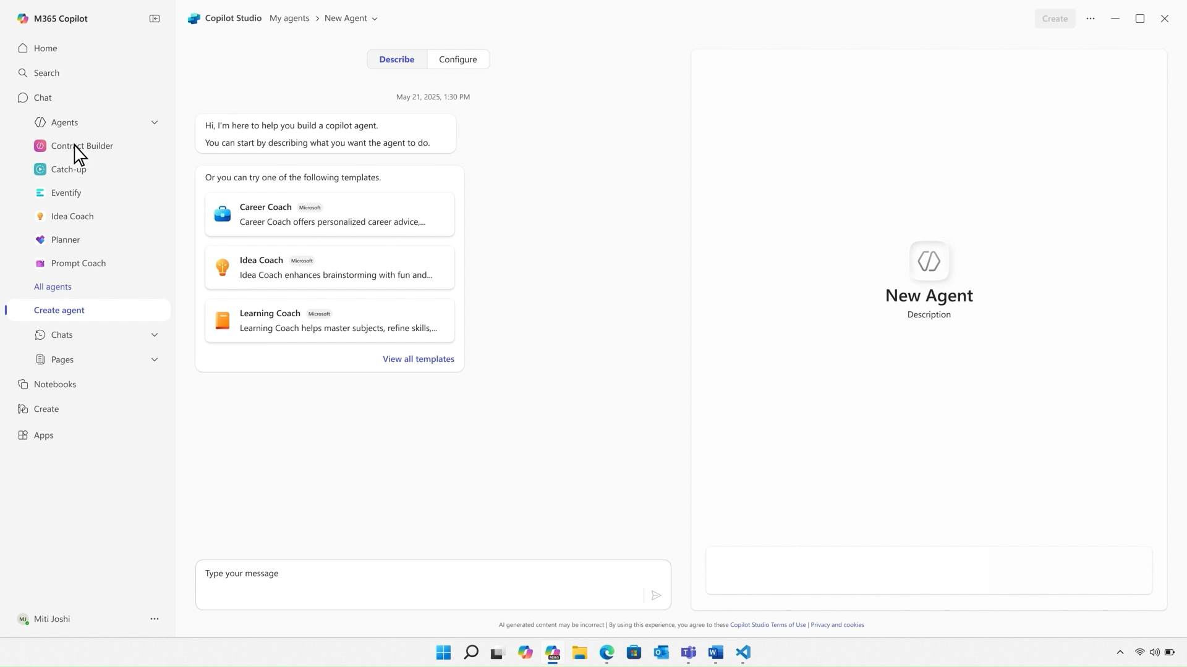
An intelligent assistant for every person
Microsoft Copilot 365
Unified AI experience for work: AI-first productivity solution combining Chat, Search, Agents, Notebooks, and Create in one seamless experience.
Build a trusted agent ecosystem: Design and deploy agents with consistent UI, standardized controls, and scalable Agent Store.
Agents that think and act like employees: Research, analyst, and custom agents use deep reasoning for specialized, task-specific work.
Notes:
Let’s talk about Microsoft 365 Copilot—the unified AI-experience for work. It’s not just another productivity tool, it’s productivity, reimagined
Microsoft Copilot 365 is an AI-first solution that brings together everything you need in a seamless experience. Chat, Search, Agents, Notebooks, and Create—all in one place. It’s , designed to meet people where they work, and to help them meet the needs of modern work by helping them work faster, think bigger, and stay focused.
What really sets it apart is how it grounds every employee’s work in their own work content—like emails, meetings, and documents. That means Copilot isn’t guessing—it’s working with the same context you are, so it can deliver insights and actions that are actually relevant.
Copilot also helps you build a trusted ecosystem of agents. You can design and deploy agents with a consistent UI and standardized controls and manage your agents at-scale through the Agent Store. It’s governance and flexibility, built in.
Agents aren’t just assistants, they think and act like employees. Whether it’s a research agent, an analyst, or something custom-built, they use deep reasoning to collaborate, automate, and drive real outcomes.

Slide 13
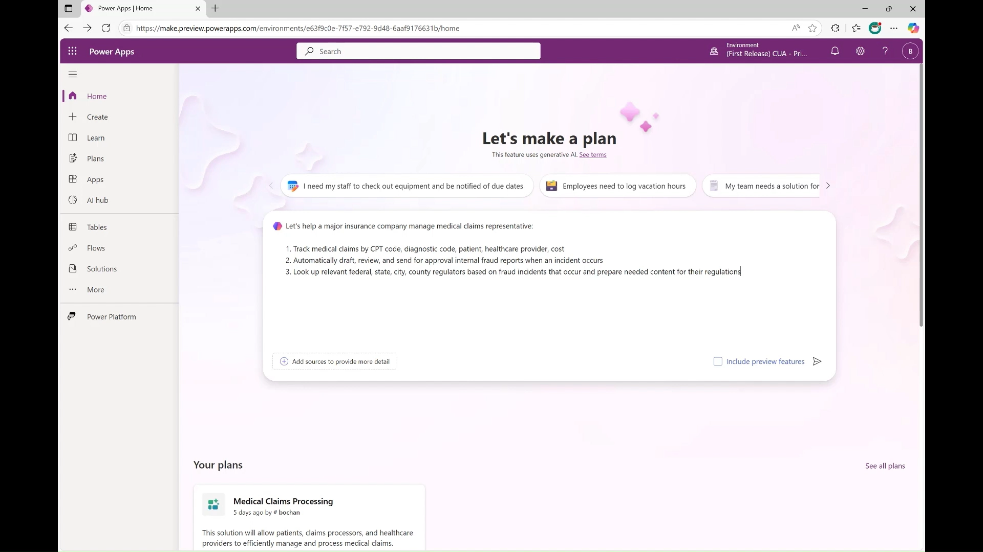
Demo
Notes:
Demo

Slide 14
Implement AI with confidence, at scale
AI operationalization done right – secure by design, integrated by default
Secure execution
Govern usage
Operate efficiently
Monitor performance
Enforce safe logic execution across agents by embedding business logic rules safely and preventing data leaks and insider threats.
Codify policies, enforce compliance, and ensure agents and apps behave ethically and consistently.
Ensure consistency and precision, at scale, with centralized deployment, management, and optimization of AI apps and agents from a single, secure control point.
Track AI impact and KPIs in real-time, and use performance analytics to uncover trends, guide improvements, and drive smarter decisions.
Enable secure, enterprise-grade AI at scale with a fully managed platform
Notes:
Let’s walk through what it really means to implement AI at scale—and do it with confidence. This isn’t just about building smart tools. It’s about making sure they’re secure, governed, efficient, and measurable.
Secure Execution: First up—secure execution. We want to make sure our AI agents are running safely. That means embedding business logic directly into how they operate, so they follow the rules. And we’re putting safeguards in place to prevent data leaks or insider threats. It’s about building trust into the system from the start. We’re keeping AI secure, compliant, and manageable—without putting extra burdens on makers.
All data used by agents—whether it’s from Microsoft 365, connected systems, or unstructured sources—is protected by the same security standards as Office apps. Thanks to Dataverse, things like MIP labels and compliance rules are applied automatically, based on who or what is running the workflow.
Security teams get real-time insights through Microsoft Purview—like spotting oversharing or sensitive data risks—without makers needing to lift a finger. Once Purview is enabled, agents inherit all the right protections. We’re also tackling AI-specific threats. Defender for Cloud Apps will soon help us catch things like prompt injection attacks as they happen.
And agent identities? Fully managed by Entra. Makers don’t need to do anything extra. It’s a seamless way to scale AI agents securely across teams and processes.
Govern Usage: Next is governance. Policies aren’t just written—they’re codified. That way, every agent and app behaves ethically and consistently, by default. It’s how we make sure AI aligns with our values and compliance standards.
Managing the full lifecycle of AI-agents—sharing, blocking, and scaling—is done by using zoned governance. This helps ensure agent skills grow in a secure, controlled way. Agents and environments can be tailored to fit business needs, using connector policies that balance innovation with control.
There’s also flexibility with Copilot licensing. Convert usage into M365 Copilot seats, apply prepaid message packs across environments, and use Pay-as-you-go to drive adoption in new areas. And track usage for cross-charging and budgeting
Operate Efficiently: Then there’s scale. We want to manage and optimize all our AI apps and agents from one secure control point. That gives us consistency, precision, and the ability to move fast—without losing control.
Monitor Performance: And finally, we need to measure what matters. We’re tracking AI impact and KPIs in real time. Performance analytics help us spot trends, guide improvements, and make smarter decisions going forward.
Understand agent usage and consumption throughout your tenant. Identify your top agents, see agent usage by groups and identify areas of opportunities to drive further adoption.
Monitor productivity changes and time savings in your org and account for how Copilot adoption is enhancing your digital transformation.
Understand the business impact of agents with the ability to bring in your business metrics and see how they relate to agent usage so you can measure business value and ROI.
So when we say ‘AI operationalization done right,’ we mean secure by design, integrated by default—and built to scale with confidence. Now it’s easier than ever to unify and operationalize knowledge across your Microsoft agent ecosystem.

Slide 15



Proven results with apps and agents in AI innovation
Automated manual processes at scale to reduce cost and complexity
Automated 80+
manual processes
Saved $6M annually
Cut compute costs by 50%
Built and AI-powered app to streamline promotions and boost engagement
Built “PromoGenius” app
500K+ monthly launches
83K active users
Transformed service delivery with
embedded AI
5x faster workflows
54% cost savings
Streamlined family services
Notes:
Let’s look at how organizations are already seeing real, measurable impact by embedding AI into their operations—through apps and agents.
Starting with Uber—one of the most operationally complex companies out there. They tackled manual processes head-on, automating over 80 of them. The result? A $6 million annual savings and a 50% reduction in compute costs. That’s not just efficiency—it’s strategic cost control at scale.
Next, T-Mobile. They built an AI-powered app called PromoGenius to streamline how they run promotions. It’s now seeing over half a million launches every month and has 83,000 active users. And it’s saved them $4M and 97,000 hours monthly. That’s a great example of how AI can drive both engagement and operational agility.
And, Epiq. They embedded AI into their service delivery workflows—achieving a 5x speed improvement and cutting costs by more than half. For a company focused on legal and family services, now saving 2,000 hours monthly, that’s a game-changer in both customer experience and bottom-line impact.
These are just a few examples of how AI apps and agents are delivering tangible business value today. Whether it’s cost savings, user engagement, or workflow acceleration—AI is no longer experimental. It’s essential.

Slide 16







97% slide
Automating over 80 manual processes in 2025 with Power Automate and Copilot Studio, saving $6M a year and 50% in compute costs.
Built “PromoGenius,” a Power App with a Copilot Studio agent, driving 500K+ monthly launches and 83K users.
97%
35K bankers use an agent to streamline 1,700 banking procedures.
Embedded Copilot and generative AI capabilities in Power Automate, reducing manual workflows by over 60 percent.
Empowered 400+ citizen developers to build 7,000+ Power Apps across 33 countries
of Fortune 500 companies use apps or agents in remarkable ways
Achieving significant savings each year, has 50k+ newly skilled citizen devs, and reduced IT demand for short-term apps by 30%
Accelerating digital transformation, driving innovation, and streamlining operations across the global enterprise with a Power Platform Center for Enablement
Deployed Copilot Studio agent inside Power Apps, automating reporting and streamlining family services—achieving 5x faster workflows and 54% cost savings
Notes:
And the wins don’t stop there.
Businesses across industries are using Apps and Agents to be more productive, more creative, save time and save money.
These aren’t just success stories, they are 10x stories. Grupo Bimbo empowered 400+ citizen developers to build more than 7,000 Power Apps. Nsure.com embedded Copilot and generative AI capabilities in Power Automate and are reducing manual insurance workflows by over 60%. Centro de la Familia cut costs by 54%.
T‑Mobile USA
Link
Built “PromoGenius,” a Power App with a Copilot Studio agent that helps store reps instantly access device specs and promotions—driving 500K+ monthly launches and 83K users.
Zurich Insurance Group
Link
Uses Power Apps and Power Automate at scale with a strong Center of Excellence—while not explicitly mentioning Copilot Studio, they are exploring AI to enhance enterprise automation.
Grupo Bimbo
Link
Empowered 400+ citizen developers to build 7,000+ Power Apps across 33 countries; some apps include Copilot Studio agents to support operational tasks like inventory and logistics.
Nsure.com
Link
Embedded Copilot and generative AI capabilities in Power Automate to reduce manual insurance workflows by over 60%, streamlining quoting and claims.
Epiq Global
Link
Uses Copilot Studio agents in Power Apps to answer legal client inquiries and automate onboarding—saving ~2,000 labor hours monthly.
Temasek Polytechnic
Link
Integrated Copilot Studio agents into student-built apps, helping automate student services and processes—saving 20K hours annually.
Centro de la Familia
Link
Deployed Copilot Studio agent inside Power Apps to automate reporting and streamline family services—achieving 5x faster workflows and 54% cost savings.
The Cxmmunity Foundation
Link
Built low-code apps for nonprofit operations; while Copilot Studio isn’t explicitly mentioned, they use AI-enabled Power Platform solutions for student engagement and progress tracking.
And many more…

Slide 17
From 70% failure to 10x impact: The AI-first shift
10x
AI-first thinking
Radical reimagination
Transformational outcomes
Notes:
As you think about your AI-powered success.
We’ve seen this statistic before, and it's critical to emphasize: 70% of AI investments fail to deliver meaningful ROI.
Why does this happen? It's rarely about the models themselves—the technology is often sound.
The real challenge lies in execution—specifically, the failure to integrate AI deeply into business operations.
When data sits disconnected across silos, systems stay fragmented. When AI pilots are isolated from workflows, organizations struggle to cale impact. Intelligence without integration is just potential—it doesn’t drive outcomes. into impact.
In short, AI without execution doesn’t matter. To realize ROI, we must embed AI into the fabric of how work gets done—across processes, teams, and decisions.

Slide 18
Get started with AI and lead the transformation
Create a winning strategy
AI boosts productivity, but a winning strategy goes further. Use AI to play both offense and defense: drive growth and reduce costs.
Find your biggest pain points
What is that one process if—faster, cheaper, or smarter—could transform your business?
Start with your data
As agents grow more autonomous, secure data grounding becomes even more essential, enabling agents to manage data and actions across disparate systems.
Future-proof your work
Empower each employee with an AI assistant as the first step—and, over time, manage a dynamic network of agents that automate, orchestrate, and scale work across your organization.
Innovate
with AI
Build an AI strategy that empowers people to amplify and scale their impacts, and to start focusing on the work that only humans can do.
Source: AI is Already Changing Work – Microsoft Included
Notes:
What’s next isn’t just about building faster—it’s about building smarter, safer, and at scale.
As we think about how to lead in this new era of AI, it’s important to approach the transformation with a structured, strategic mindset. It starts with creating a winning strategy—one that doesn’t just chase productivity gains, but uses AI to play both offense and defense. That means driving growth while also reducing costs. From there, we need to identify the biggest pain points in our business.
Ask yourself: what’s the one process that, if it were faster, cheaper, or smarter, could unlock real transformation? That’s where AI can deliver immediate value.
But none of this works without data. As AI agents become more autonomous, grounding them in secure, connected data is critical. It’s what enables them to act intelligently across fragmented systems. Once that foundation is in place, we can begin to future-proof our work. That starts by empowering every employee with an AI assistant—then scaling up to a dynamic network of agents that automate, orchestrate, and elevate how work gets done across the organization.
And finally, we need to innovate with AI—not just to do more, but to do better. The goal is to amplify human impact, freeing people to focus on the work that only humans can do. This is how we lead the transformation—not just with tools, but with vision, clarity, and purpose.
Suggested calls-to-action:
Option 1: Follow-up meeting with key stakeholders: Engage their technical and business teams to dive deeper into needs and challenges using the next-level presentations for the FY26 Solution Play.
Option 2: Industry-specific value prop and use cases: Present customer success stories relevant to their industry.
Option 3: Schedule a Business Value Assessment workshop to align Microsoft solutions with business objectives.
Business Value Assessment- GBB Engagement Request App - Power Apps
App in a Day (App in a Day)
Admin in a Day
RPA in a Day
Copilot Studio in a Day

Slide 19
Thank you

Slide 20

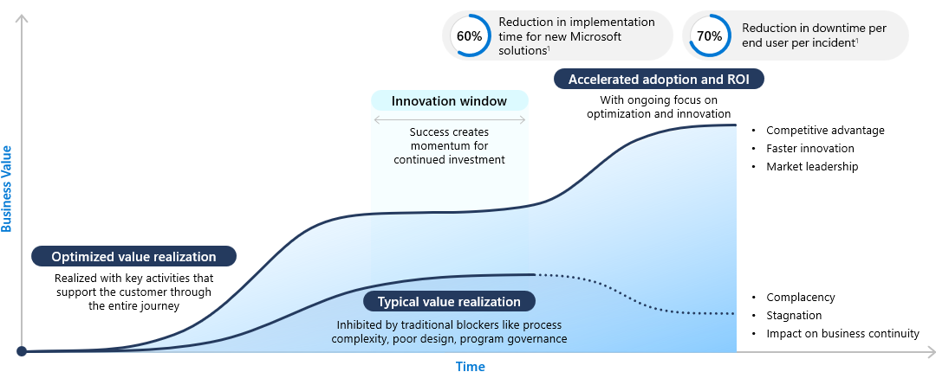
PACE for Power Platform
Build enterprise-wide capability and skills with guidance from our experts
Rapidly innovate and transform business processes with apps and agents with knowledge transfer and best practices
Secure the enterprise with governance and security guidance
Create business value with Value Acceleration Services
¹Source: The Total Economic ImpactTM of Microsoft Unified March 2025: A commissioned study conducted by Forrester Consulting
Notes:
PACE for Power Platform

Slide 21
Deployment Success Program (DSP)
Accelerate your deployment with a team of subject matter experts
Increase the likelihood of project success with solution architecture design validation and development processes
Lay a solid foundation to support future deployments
Create business value with Value Acceleration Services
¹Source: The Total Economic ImpactTM of Microsoft Unified March 2025: A commissioned study conducted by Forrester Consulting
Notes:
Deployment Success Program

